Slide 1
Promouvoir
Notes:
Appât :
Message :
Bénéfice :

Slide 2
Méthode
Cibler
Angler
Rédiger / Illustrer / Enrichir
Optimiser
Promouvoir
Dialoguer
Mesurer

Slide 3
Agenda

Slide 4
Problématique du “last mile” : vous pouvez avoir le meilleur contenu, faut le faire savoir (pour qu’il soit reconnu comme tel) métaphore fibre – coaxial :
Pas envie de vous adresser uniquement à la long tail (en ne faisant rien) ?
Rappel objectif : ce n’est pas le trafic mais la transfo de ce trafic qui compte
1h d'écriture = 1h de promo
Provoquer une réponse émotionnelle
Choisir le bon timing
Promouvoir ... et faire promouvoir (rôle d’ambassadeurs car lecture est devenue sociale): d’après Comscore 16,6% du temps passé en ligne en 2011 = sur les réseaux sociaux (>portails)
Step 1 : dire à Google quels mots-clés sont les plus pertinents pour vos cibles
Step 2 : Facebook, Twitter sont de parfaits systèmes de distribution organique pour vos fans et amis (page fans, flux rss dans onglet articles...)
Step 3 : Blogs (comme guest writer par ex., Digg, Reddit, annuaire d’articles...
4: SEA
5: offline (communiqués de presse, mails, folders, pubs...)
=> CONTENUS + PROMOTION = LIENS

Slide 5
LINK building
Notes:
Back links = inbound links = liens externes entrants : + de trafic, meilleur SEO…

Slide 7
Liens = facteur n°1
Liens entrants (‘backlinks’)= facteur numéro 1 pour le Page Rank, devant les signaux sociaux et l’engagement des internautes (bon lien doit veir d’un site avec PR de 4 ou 5 minimum, d’un site de la même thématique, étant une autorité, sur une page qui a peu ou pas d’autres liens, avec ancre pertinent sur vos mots-clés)
Liens entrants déterminent la fréquence des robots et la profondeur de recherche des robots ds le site
Principe de base du « link juice » : chaque lien est un vote, une approbation éditoriale, qui a plus de poids (PR, ou celui de sa homepage puisque Google ne com pas sur le PR des sites) si le site qui pointe est lui-même bien considéré par Google (il « passe » une partie de son PR, + ou – fort en fct du nbre de liens qu’il « passe »)
La valeur du lien est aussi déterminée par le texte d’ancre, la pertinence du lien entre les deux pages (même sujet ? Même requête dans Google ?), l’autorité (être un hub dans son domaine) et la confiance (trust, par rapport aux spams, être le plus proche de la racine qui est sans spam). Moins importants : l’indépendance de la source (par rapport à la cible du lien), le nombre de liens reçus d’un même site source (+ de liens ? => chacun pèse moins lourd), diversité des pages sources de ces liens, dates d’apparition/disparition de ces liens (par rapport à création du contenu principalement…), contexte/pertinence (liens à proximité, position du lien sur la page, texte proche, catégories de contenus la plus proche…),
vous devez maintenant essayer de rester un maximum dans votre thématique
Un autre critère important à prendre en compte lors de l’obtention de liens hypertextes est la qualité du site. Vous devrez faire attention à son PageRank, plus il est supérieur au vôtre et mieux ce sera.
Vous regarderez si ce site n’a pas été pénalisé par Google
Enfin, d’autres critères seront intéressants à prendre en compte comme le nombre de pages indexées (totales et les dernières semaines), le nombre de pages pertinentes indexées, le nombre de liens entrants sur le site, etc.
Link Building : attirer ces liens, en permanence, en tenant compte de ces éléments de valorisation.
Lien à optimiser à la fois pour la page qui le contient et pour la page vers laquelle il renvoie
Évitoins les liens non textuels (images, JavaScript, formulaires, flash…)
Le

Slide 8
Obtenir des liens entrants
Payer (ou commercial car réseau de revendeurs par ex.) = pas de valeur éditoriale -> Google déteste ça
Echanger entre sites = peu de valeur éditoriale a priori, à éviter (mais ça reste populaire) – si vous le faites (partenairats forts), essayez des liens triangulaires plutôt que réciproques
Susciter une réaction émotionnelle (si uniquement pour raisons de liens alors = « link baiting ») = valeur pour le PR («émotionnelle », ou info unique et puissante, ou outil utile…) : CONTENUS VIRAUX
Sites similaires à viser - related:
Se poser en expert, minimiser l’aspect commercial, pas de pub même déguisée
syndication de contenus (sur un autre site comme Ezinearticle.com) , social news (digg, stumbleUpon, Reddit, Delicious…), réseaux sociaux, blogs, annuaires,
voir où les concurrents ont des liens (via logiciels comme Open Site Explorer par ex.)
Guest posts
Concours avec prix à la clé
Créer un contenu controversé
Être présent dans les annuaires
Faire des classements / top lists
Créer des bages à insérer sur les sites (guru.com ou elance.com)
=> Utiliser des contenus de qualité (textes, vidéos, outils, images, jeux…) pour attirer des liens = piste n°1 !!!

Slide 9
Rajouter des liens dans les autres articles vers celui-ci si c'est pertinent Inviter au partage (et commentaires)... pour de bonnes raisons, en provoquant de préférence une réponse émotionnelle (engagement) Tags (visuel = wordle) Priorité à votre communauté : privilèges X-référencement : mise en avant, floating display, Newsletters, ADmail, magas papiers... Relais externes possibles : réseaux sociaux, partenaires, forums, blogs... Bon timing de publication/promo ......

Slide 10
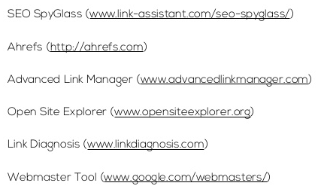
Outils
comme Majestic SEO, Ranks.nl ou encore Open Site Explorer.

Slide 11
X-medias

Slide 12
socialiser
Plus de liens vers votre site
Plus de présences en ligne = plus de chance d’être vu par les internautes et les moteurs
Les réseaux sociaux devienent des moteurs de recherche
Google utilise des infos de google +
Liens vers contenus essentiel (forte valeur ajoutée dans votre core business et pérénité) sur la homepage
Pensez au guest writing (volume et auto-promo assurée) mais faut encadrer
4 types de cibles : influenceurs, moteurs de recherche, trafic payant, syndication de vos contenus
Developing a Social Media Conversation Calendar
Share CMI
Twitter
Facebook
LinkedIn
Google +1
Pinterest
Print
It’s well known that social media presents a tremendous opportunity for businesses to connect directly with their customers and potential customers. But, at Sprout Content, we hear all too often, “I started a Facebook page, but what do I say?”
Social media Conversation Calendars are a great way to not only develop your content strategy for social media, but also make the process more efficient and keep your posts updated regularly. Here are few guidelines that will help you get started.
Determine who and why
First, you need to develop a social media content strategy. You have to know who you’re trying to reach and why. Identifying your target audience and the kind of information they’re looking for is essential.
For example, if you’re an organic snack food company trying to reach moms, think about what moms would want to know about your product or hear from your brand. Then, create three to four “buckets” of information that each post should connect back to, such as healthy ingredient information, health topics for kids, brand news, and conversation starters with moms. Once you start developing your calendar, create a column for each content bucket to keep you on track. (More on that shortly.)
Develop your voice and tone
Many brands and companies make the mistake of posting inconsistently from a different voice or perspective. Decide upfront if you are going to post and respond from the first person “I” or from a personal, yet collective brand/business perspective “We.” You can also use a more neutral third person without the use of a pronoun.
Choosing the tone of your content is also important. Is your brand’s social media personality light and friendly or serious and informative? Be consistent when writing posts and responding to fan feedback or questions.
Start your conversation calendar
Conversation Calendars usually include two to three of your planned posts per week for an entire month. Keep in mind that topics and posts can, and will likely, change depending on current news or last-minute promotions. No matter what, the calendar will set the foundation for your social media engagement and ensure you are posting regularly.
After your audience is established (e.g., moms), and your content strategy is determined (topic buckets), it’s time to decide what to write about. Need ideas? Look at the news, industry trends and blogs for inspiration, as well as any relevant company information such as new products or services and special offers. Also, think about the questions that your customers ask most often.
Here’s a simple set up for a social media conversation calendar:
Set up a spreadsheet with monthly worksheets, and create columns for the post date, day of the week, content bucket, anc actual Facebook and Twitter posts.
Upload the conversation calendar to your daily calendar or shared calendar/Intranet, etc. if there will be more than one person posting.
Own your social media content
Whether you are a business of one or 1,000, someone must be in charge of your company’s content strategy, creation, approval and governance. Establishing your social media content process and designating responsibilities for managing it are essential steps.
Who is responsible for developing, writing and posting according to schedule?
Who is responsible for monitoring and responding to comments in relative real time?
Measuring success
Finally, you have to determine how you will deem your social media content a success. Social media is only valuable for businesses if you use it to meet specific objectives. These may include an increase in the number of fans or followers, an increase in feedback, “likes”, or “shares,” or a boost in website traffic. Here are a few easy tools that can help you get started.
Hootsuite lets you monitor most of your social networks in one place.
Facebook Insights offers numbers on engagement, “likes” and users.
Social mention is a free tool for real-time social media search results. Sign up to receive free daily email alerts for your company, product, a news topic or even a competitor.

Slide 13
Intégrez vos vidéos dans vos fils RSS
Partagez vos vidéos (FB, Twitter…) pour augmenter leur visibilité, selon votre stratégie (buzz ou trafic sur votre site, voir un mix avec teaser par ex.)
Favorisez les commentaires et les votes
Favorisez les intégrations de votre vidéo dans les

Slide 14
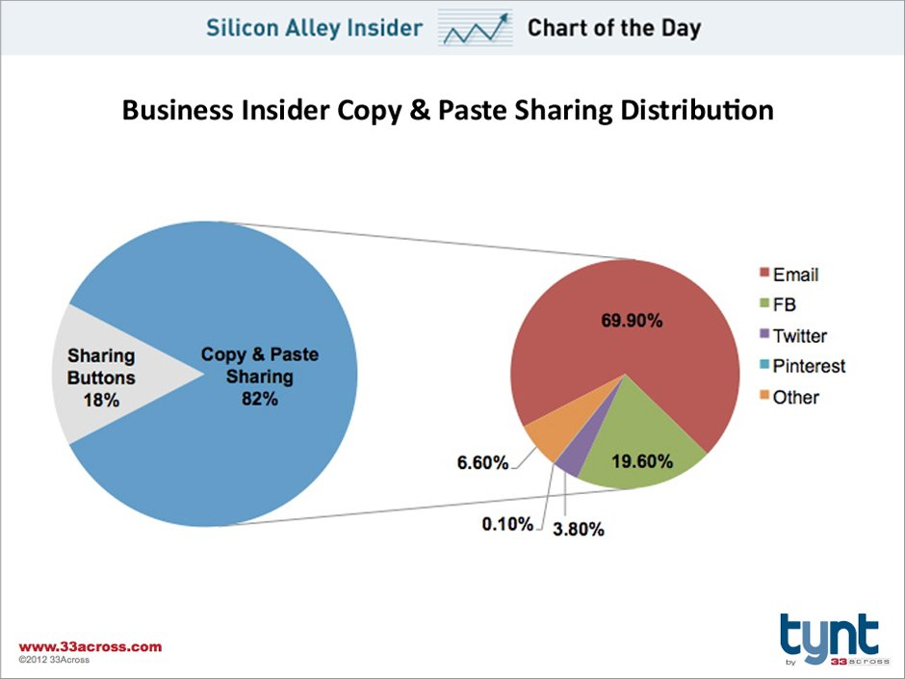
Copier-coller

Slide 15
Réseaux sociaux

Slide 16
Choisir
Dessin site au centre

Slide 17
Choisir
Not all Social Networks are Equal.
When it comes down to sheer popularity Facebook is the social network that wins.
Facebook is also about “Identity” whether that is a personal profile or a “business brand” persona.
Twitter is about “Events” which could be the next plane crashing into the Hudson river or letting your audience know that your latest blog post is published…that is an event!
Google plus is “Core” and is woven into the science of search as Google embeds it into every one of its web properties from Picasa to YouTube.
It cannot and should not be ignored by marketers as social signals are now being measured and monitored by Google machines and is being woven into the DNA of search. Optimizing your online assets (blog and website) for search engines is vital.
Different social networks will be need to be included in your social media marketing strategy depending on your goals, audience and tactics.
Don’t Ignore LinkedIn
If you want to communicate to a B2B audience and business professionals then LinkedIn with its 150 million members is a good place to play.
If you want to engage with the business leaders and executives then it is the first channel to turn to.
Read more at http://www.jeffbullas.com/2012/03/06/how-to-harness-the-power-of-linkedin-infographic/#8ET3uWUqlG10JSxq.99

Slide 18
Choisir
Notorété
Visibilité
Différents réseaux… et potentiels
Pièges à éviter
Rechercher des infos viia les réseaux sociaux
Un belge sur 3 sur les réseaux sociaux pendant que regardet TV écoutent radio (IAB INsites), 2013)

Slide 19
Principes généraux
Contenus de qualité
Titres magnétiques
Titres assez brefs
Description explicite avec CTA (meta ?)
Image accrocheuse
Hashtags appropriés (quand pertinent)
Faciliter et pousser au partage (boutons)

Slide 20
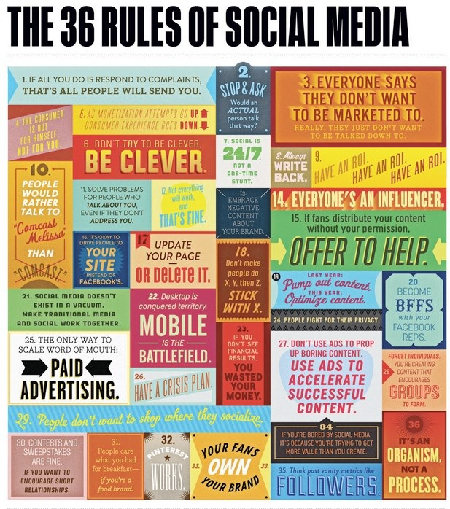

Slide 21
Ambassadeur / Advocacy

Slide 22
Engagement
Previous
Soft Launching SEOTools.net
Next
Counterspin on Shopping Search: Shady Paid Inclusion
Engagement Marketing 101
Nov 13th
by PeterD
12 comments
posted in
marketing
Getting traffic to a site is one thing. How do we best engage visitors once they arrive?
Since Update Penquin/Panda, engagement metrics have become more important. In order for our sites to rank well, we need to avoid the bounce - the immediate click-back - or we’re likely to experience drops in ranking. We need to pull visitors deeper into our site. We need more genuine engagement.
Even if engagement metrics had no impact on rankings, optimizing for engagement is always going to be beneficial. The more engaged our audience, the more influence we’re likely to have, and we derive the benefits that flow from it.
Here are a few ideas on visitor engagement, and how to optimize for it.
Two-Way
When visitors have so many options, it’s difficult to engage them for long. We can’t accommodate every need on one site. It’s certainly impossible to accommodate every need within one or two clicks. So, to make the most of every opportunity, we should be optimizing engagement factors.
One problem with content-based approaches is that they tend to be top-down. The visitor is assumed to be a somewhat passive recipient of published information. However, at the heart of engagement is a two-way conversation. In order to foster engagement, we must encourage participation, as opposed to simply deliver content.
The web is moving from an information age to a relationship age. Social media demonstrates that information is intersecting in new ways. Information is being sliced, diced, repurposed, remixed and redelivered, turning “recipients” into producers. The act of consumption changes the information, and often creates new information. Conversation, as discussed in the Cluetrain Manifesto, is crucial in this new economy.
“Historically, the authors state, the marketplace was a location where people gathered and talked to each other: they would discuss available products, price, reputation and in doing so connect with others (theses 2–5.) The authors then assert that the internet is providing a means for anyone connected to the internet to re-enter such a virtual marketplace and once again achieve such a level of communication between people. This, prior to the internet, had not been available in the age of mass media (thesis 6.)”
And that conversation will largely be decided by our visitors. It certainly reshapes marketing. To give an offline example, what’s the problem with marketing television and radio? We watch or listen to the content, but the marketing keeps jumping in, which is intrusive and disruptive.
Engagement Marketing is the opposite. The marketer hangs back and engages with the visitor of and when they need it. Look for ways the visitor can initiate and direct the engagement.
Benchmark/Define Success Metrics
How do we best measure engagement?
We start with a benchmark, which is the current level of engagement. We could look at the engagement link in Google Analytics. Typical measurements include time on site, pages per visit, inbound links, mentions on twitter, return visits, new users per date range, categories of interest, and page depth.
All good. If those metrics increase, it certainly feels like we’re being more engaging. One example might be to examine visitor flow through the site. If we can identify bottlenecks - the point where engagement breaks down - then we can adjust our approach at this point to clear the bottleneck.
But we need to be sure this engagement benefits us. Are these metrics aligned with our business goals? People might well be spending a lot of time on our site, but that might be because they’re lost. We might be getting a lot of mentions on Facebook and Twitter, but are these people actually buying anything? Mentions on Twitter & Facebook might be great metrics for a brand strategy, but not so great for conversion strategy, at least, not in the short term, and not in isolation.
Engagement must translate, and be aligned with, business goals. When choosing what engagement metrics to measure, ask yourself how this type of engagement helps achieve your goals. Also, are there other types of engagement we could foster to support own goals?
Practical Lessons In Engagement
This video is a little sales pitch-y, but contains some interesting lessons on optimizing engagement.
Optimizer, Dan Siroker, who once worked for Google before moving onto the Obama campaign talks about how they used metrics to increase engagement. Both Obama campaigns have demonstrated effective use of digital engagement and measurement to help produce a desired election result. The techniques involve establishing a baseline i.e. seeing what they do already and increasing performance by making tweaks and adjustments, and measuring the result.
He found that, generally speaking, these rules apply when optimizing for engagament:
Start By Defining Success: How will you know if your engagement optimization has worked? Decide on a few, quantifiable measures based around a visitor taking a desirable action. Link those actions to business return.
Less Is More - if we reduce choice, people are more likely to engage. In this example, they reduced the fields people needed to fill in to only those actually required, rather than all the information that may be desirable. Look for ways you can streamline and thus boost engagement.
Words Matter - focus on your call to action. Calls to action tend to work best when you tell the visitor exactly what they have to do. Be explicit. In this example, they compared the phrase “Free trial” vs “Try It Free”. The latter resulted in 14.6% improvement. This was most likely because it was an explicit call to action. However, the “why” doesn’t really matter. The point is to measure one thing against another and see what actually works.
Fail Fast And fail cheap!. It’s all about being iterative. Being flexible. Trying things out. The underlying presumption is that a lot of things we do aren’t going to work, no matter how logical and rational they seem to be when we devise them.
So, rather than be afraid to make a change, as this may result in failure, grasp the opportunity to make a change and be sure to “fail fast”. If something is not working out, cut it quickly, and try something else, until it does work. If it hurts, dump it quick and move on.
Start Today It’s easy to talk about being engaging, but what really matters is taking action to be more engaging. If there’s one thing you can do today to make your site more engaging, what would it be? Go do that. Test it. And then do something else tomorrow :)
In the video, Dan talks mostly about process changes. Another area is, of course, web design. This article talks about the influence of design on engagement, based on opinion on what design is preferable to another.
If we go back to the rules of engagement, the important thing to do is to test. Test one design against each other to see which is more engaging based on desired visitor action. Ensure the engagement measurement is aligned with a business goal i.e. “we want more 50% orders via our web site”.
Social Media Engagement?
Do Blogs, Twitter and Facebook help you meet your engagement goals?
Is anyone reading our posts? If they do, what do they do next? Anything? Many people are very busy in this space, but generate little or no return on investment. When it comes to engagement, it’s one thing to measure activity, quite another to measure if that activity actually means something.
Part of the problem is not focusing on ROI. Determine your business goals, then shape your social media approach to bring about these goals. One example might be “Twitter traffic makes a donation to our cause”. We’d measure the Twitter traffic, and link it to a successful donation.
This is a good example of where metrics can be deceptive. If we measured Twitter traffic, and time on site, and depth of their activity on-site, that might look great in terms of engagement, but if it doesn’t serve a business purpose, then why are we doing it? If people spend more time on site, is that good? Well, not if we want them to sign up, but they didn’t
Engagement Media & Strategy
There is no substitute for relevance. Relevance is the first, essential step. The next step is pull the visitor in, get them contributing, and get them coming back.
Alan Moore, Director of the Comparative Media Studies Program at MIT, puts it well:
Engagement marketing is “premised upon: transparency - interactivity - immediacy - facilitation - engagement - co-creation - collaboration - experience and trust, these words define the migration from mass media to social media. The explosion of: Myspace, YouTube, Second Life and other MMORPG's, Citizen Journalism, Wicki's and Swicki's, TV formats like Pop Idol, or Jamies School Dinners, Blogs, social search, The Guinness Visitor Centre in Dublin or the Eden project in Cornwall UK, mobile games like Superstable or Twins, or, new business platforms like Spreadshirt.com all demonstrate a new socio-economic model, where engagement sits at the epicentre
In order for the following media examples and strategies to work well, they should have as many of these qualities - transparency - interactivity - immediacy - facilitation - engagement - co-creation - collaboration - experience and trust - as possible. No doubt you've experienced the frustration of heavily moderated and delayed visitor comments on mainstream media acticles. They rob the interaction of immediacy and trust, so it’s no wonder their business model is dying in the face of relatively open and immediate citizen media and reporting.
A quality content strategy is likely to keep people reading, bookmarking, and coming back. Quality is, of course, relative. Compare your content with that of your opponents. Obviously, your stuff needs to be better. Even if people do click away, they may well return if they look at your competitors and find their quality lacking.
Video and audio are linear, so people, once engaged, are likely to engage as long as the media lasts. Likewise, webcasts engage people in the same way, with the added bonus that visitors can interact, if they wish. If increasing time on site aligns with your business goals, then video and audio might be good media to try.
People love giving their opinion. Look for ways to allow them to do so. Blog comments, obviously. Forums. Encouraging people to Tweet or post to their favored social media channel. Implement chat applications, where appropriate, to seek direct feedback. Amazon’s value is considerably increased by their review system - by giving their customers a voice, whether their opinion is positive or negative.
Use mailing lists. These are especially useful for up sells and cross sells post-purchase. Up-sells are when you encourage the customer to buy something more expensive. Cross-selling is when we sell the existing customer an additional item. I receive special discounts from a clothing retailer I buy from on a regular basis, based on my previous buying history. This retains engagement after I've left the site, and because it's relevant and beneficial, it doesn't feel intrusive. It’s considerably more expensive to get a new customer, rather than look after those customers you’ve got, so look for ways to pass on that value to existing customers. They are likely to be highly receptive and willing to engage, as you’ve already convinced them once.
Brand. A huge topic, but let’s take a look at brand in terms of engagement. A brand is an experience. We associate feelings and thoughts with a brand. Apple’s brand is as much about technology as it is about fashion, desirability and identity. Apple creates engagement on a number of levels, but perhaps the most effective is that you become a “member of a club” when you buy an Apple product. The sense of belonging, and defending and asserting your purchase in the cleverly constructed “Apple vs everything else” debate creates a deep level of engagement.
Try to foster a sense of community. It runs very deep in the human psyche. We used to get a sense of community by geographic location. but now our sense of community is largely defined by the tribes to which we belong.

Slide 23
Inciter au dialogue : les internaute sont prêts à contribuer à la vie de la communauté afin que la marque leur donne la parole. L’incitation à la parole qui se caractérise le plus souvent par le commentaire peut passer, entre autres, par des appels à contribution ou des rendez-vous récurrent : un sondage proposé au lecteur un jour dans la semaine, le pour ou contre sur un sujet donné ou encore le « connaissez-vous ? ».
Avoir un dialogue ancré dans la réalité et l’actualité : la communauté cherche une connexion émotionnelle, un message qui les touche personnellement. Il faut éviter de se focaliser à tout prix sur ses objectifs. Il s’agit plutôt d’être en phase les événements actuels. La solidarité est toujours bien perçue et aide la communauté à se rassembler : poster des messages de soutien pour une cause ou leur souhaiter une bonne journée par exemple.
Avoir du répondant : donner la parole aux internautes, c’est bien, leur répondre c’est encore mieux afin d’entrer en interaction avec eux et produire un échange personnalisé. Cela leur donnera l’impression d’être pris en considération, en retour la présence de la marque sur les réseaux sociaux bénéficiera d’une plus forte crédibilité.
Opter pour l’humour : animer une communauté c’est la distraire, l’émerveiller, la faire «marrer” pour qu’ils en redemandent et ainsi établir une certaine dépendance. Les membres sont friands de contenus amusants et légers et sont très attentifs aux publications qui font la différenc.
Publier du visuel : l’image permet de créer un univers visuel et suscite davantage d’intérêt que le texte d’autant plus que l’image est le contenu qui génère le plus d’engagement de la part des internautes. Ce sont en effet les contenus les plus republiés et partagés.

Slide 25
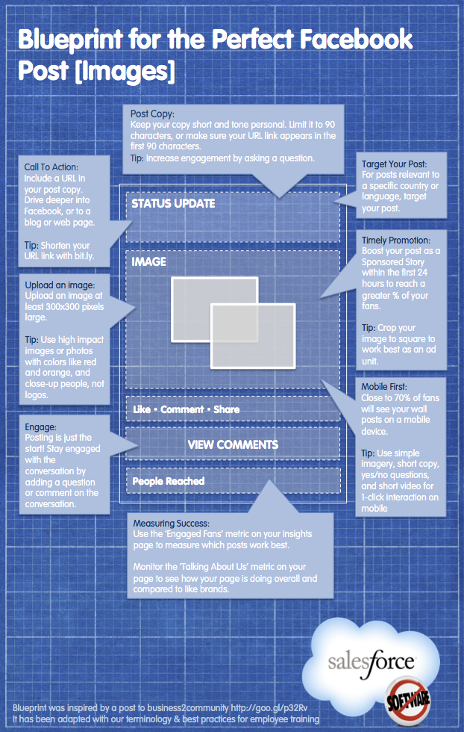
Facebook
Notes:
Réseau le plus populaire
Formation spécifique

Slide 26
20 Ways to Increase Your Facebook Likes and Engagement
Advertise on Facebook to get more “likes”. This is the quickest way to grow your fan base. The Supre fashion brand did this to obtain 40,000 fans quickly.
Rotate your ads “DAILY” people get tired of hearing the same thing in conversation so change your ad! Conversion (CTR) rates can drop by 50% after the first 24 hours. Do not “set and forget”
Add Facebook Social Plugin Box to your Blog and Website (60% of my “likes” are achieved this way)
Free exclusive video that can only be viewed if you like the page.
Run a competition. Everyone likes a competition
Make it obvious on a custom landing page by providing a big bold “Like our Page”
Initially ask friends and family to like your page. A bit overdone but essential at the beginning
Offer a free ebook to obtain a “like” (just like you should be doing for email subscriber acquisition)
Post content from your blog to Facebook whenever you write a new post. Facebook users love receiving new content on Facebook without having to go looking for your blog. Treat Facebook as an extension of your blog.
Provide enticing high resolution photos. Compelling photos that are appropriate for your target audience will keep them coming back and make them share and so drive more likes from their friends
Ask questions regularly using Facebook’s native question app.
Include a link to your Facebook page in your email signature
Provide a compelling welcome video on your Facebook landing page
Simple but often missed: Add a “follow us” on Facebook button near the top of your website and blog pages
Create an incentivised “Like” page that gives people a reason to like your page.
Include the Facebook like button on your email HTML template so that people can like your facebook page from the regular email newsletter
Add a large custom banner to your blog and website asking to “Like
Add a link to your Facebook page as one of your three LinkedIn website links that are part of your LinkedIn settings in your profile
Add a newsworthy update that is relevant for your industry or market niche to your Facebook page every day
Offer “Special” including discounts to Facebook fans. The majority of Facebook users “like” a page to obtain a discount
Read more at http://www.jeffbullas.com/2011/09/09/20-ways-to-increase-your-facebook-likes-and-engagement/#JH40ShiHemIUeP2t.99

Slide 27
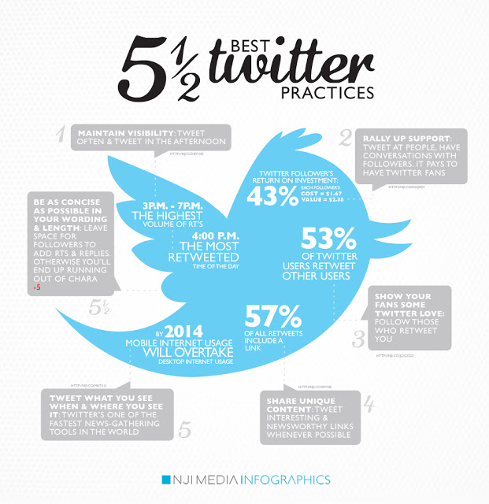
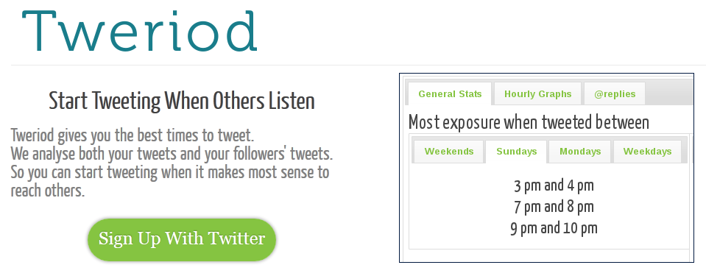
Twitter
Raccourcissuer
Hashtag
Longueur
Période
Ton
12 Keys to Success on Twitter
Written by Jeff Bullas - 44 Comments Categories: Social Media, Social Media Marketing, twitter
Twitter was never designed to be a social network but it has become one.
In fact it was designed initially in 2006 to used by individuals as an SMS type service to communicate with a small group at the podcasting company Odeo. When I first joined Twitter in 2008, I was underwhelmed and wondered as to its usefulness. Its early attraction to me was its novelty factor. It has overcome this challenge and four years later it has built an impressive resume.
Over 140 million active users as of 2012
Generates over 340 million tweets daily
Handles over 1.6 billion search queries per day
Tenth most visited site on the internet
In the nearly six years since its founding over 600 million users have registered Twitter accounts.
Twitter Provides Leverage
This is Twitter’s biggest and best advantage.
Social media allowed the word “viral” to be associated with marketing rather than the great plagues of the last few centuries. It has enabled the localised and physical word of mouth to now become “world of mouth”.
Social media with its exponential multiplier effect is the amplifying agent that marketers used to dream about. Many business owners still do not understand the global multiplying effect to word of mouth that it brings.
What I Discovered about Twitter
Despite not being impressed initially with its rather simple interface and perceived lack of usefulness I stuck with tweeting an occasional tweet here and there. After playing with it for a few months I discovered it was driving traffic to my blog in numbers that surprised me. It now had my undivided and focused attention!
I realised that if I wanted more traffic to the blog then building a large Twitter tribe of followers could be a great benefit to providing more visibility to my blog.
One Tweet at a Time
Stephen King, the fiction writer who has written 47 novels and according to Forbes earned $39 million last year, when asked, how he was so prolific and successful, had this to say.
“How do you write?” I invariably answer, “One word at a time,” and the answer is invariably dismissed. But that is all it is. It sounds too simple to be true, but consider the Great Wall of China, if you will: one stone at a time, man. That’s all. One stone at a time. But I’ve read you can see that motherfucker from space without a telescope.” ― Stephen King
Being successful with Twitter is no different. One tweet at a time.
12 Keys to Success on Twitter
Success on Twitter will take time. It will require patience and persistence. There are many online services promising overnight success. True success takes longer and it takes discipline and commitment.
1. Size matters on Twitter
Don’t believe it when people tell you that its just the quality and not the size of your following on Twitter that matters.That is bollocks! Both are important
A large Twitter following provides scale and leverage to market your business, blog or website.
Building a Twitter following applies the law of reciprocation. If you follow someone then there is this underlying obligation to follow you back. The more credible your account looks with credibility displayed by links to a blog and a sizeable Twitter following will make you more attractive to be followed back.
2. Build a targeted tribe on Twitter
This is where it starts to scale when you not only have a big following but a tribe that wants to hear what you have to say and links that take them to valuable content that they want to read and view, whether it is yours or another trusted source.
Your tweets need to be relevant to your followers. If you want to build a targeted following then I have found that Tweepi is a great tool to assist you with that (and it is free).
Applying the law of reciprocation, follow people’s (preferably top bloggers with large followings) followers in the market segment that you’re focused on. In the main these followers are already following that person because they are interested in that topic area. It is a list that is already qualified for you.
For example if I follow Chris Brogan’s followers then I am quite confident that they are interested in social media. If I tweet about social media then they are going to be interested in my links.
There are other tools that you can use to build a Twitter following and another on I use is Twellow, that is like the yellow pages of Twitter.
3. Tweet “evergreen” content
Online your content defines you.
The challenge for many is coming up with the ideas for tweets and the content that they lead to.
Stephen King reveals the secret to finding the inspiration and ideas for your content- ”you want to be a writer, you must do two things above all others: read a lot and write a lot”
Some people fall into the trap of just tweeting news and topical content.
If you want to build and enduring presence on Twitter and on social media including blogs then link to content that is useful and helpful not just this week but also next week and in one years time.
Link to content such as “how to” videos or articles that adds value well into the future and isn’t dated within 24 hours because it is now “old news”. Aim to educate, entertain and inspire and not just inform.
4. Include links to liquid and contagious content
Tweeting great content is essential.
If you want people to share you then you need to make your content compelling and contagious. That could be through assisting people in solving problems.
It must do one of 4 things, inform, educate, inspire or entertain. This takes work but it can be done.
Create content that is so good it begs to be shared. Coca Cola have realised the power of this and have changed their marketing strategy from “creative excellence” to “content excellence”. Their strategy is labelled as “liquid and linked”.
5. Tweet multimedia content
On Twitter people expect to be taken to content that is multi-media rich. It needs to include media such as videos, Slideshare presentations, podcats, images and photos.
So think multi-media tweets. Twitter is now allowing you to view these within your Twitter account.
6. Visual tweets are vital
There is a significant trend happening on the social web and it is the increasingly important communication technique of getting your message across via visual formats and media. It is showing its power with the rise and growth of platforms and social networks such as Pinterest and Instagram.
It is also evident with the obvious popularity of Infographics. It can be seen in the evolution of Facebook and the emergence of Google+. The images are bigger and beautiful than ever before. Share them on Twitter and watch your engagement and your content sharing grow.
7. Automate Twitter
Many social media purists don’t agree with this but it works and saves a lot of time. I have been labelled a Twitter maverick by some but my principle on this is to “automate the content distribution but not the conversation“. This balances efficiency with engagement. I automate the tweeting of my content about 90% of the time. It provides visibility online and it keeps my content in the Twitter stream. I tweet on average one tweet every 15 minutes.
The two tools that save me 60-70 hours a week and let me sleep are Twitterfeed.com and Social Oomph Professional (a paid service that costs me about $25 a month)
Productivity tool #1. Socialoomph
This saves me about 80 hours a week at least. I use social oomph several ways but mostly for these two tasks
Automates the sending of my tweets
Automatically follows people back ( I can’t follow manually back 3,000 people a month, I need to sleep!)
Productivity tool #2. Twitterfeed
I enjoy sharing other bloggers content that I trust. Twitterfeed.com enables me to share their content on Twitter automatically by detecting their RSS feed when they publish their post.
It achieves two objectives. It enables me to continue to share content that adds value and secondly sharing content from other bloggers sometimes ends up in them sharing your content. Send it with their Twitter handle so they know you have tweeted their link. That is what I call a win-win!
8. Learn the art of the Twitter headline
In a world where everyone is time poor you have only seconds to make them click. Your headline is the start of the seduction. It applies to all of your content but on Twitter it is vital.
9. Tweet to all your social network accounts
We all have our preferred social networks. Some are Facebook fanatics, others are LinkedIn legends and some are Twitter twerps. Don’t miss a chance to get your content and brand where your customers hang out. Tweet links to content on a variety od social networks.
Edelman publishes a trust barometer every year to measure what creates trust online. They have discovered that if someone only sees your brand once your trust factor is only 4%. If they see you mentioned 3-5 times it rises above 50%.
The lesson here is “be seen everywhere” Tweet links to content that is published to the major social networks in a variety of formats.
10. Tweets should have a home
Your Twitter account should link to a home that you own. You should also be tweeting links to take people to that hub (it could be a blog or a website). Don’t build your home portal to the web on someome else’s platform. Build your own foundation and hub. This should be a blog with your domain name and that is self hosted.
Don’t sign away your rights to your content to someone else. Sure, post your articles to your Facebook page or a Tumblr account but don’t hand over the keys to a landlord, you never know when he might want to sell or demolish your home. Invest in your own online asset.
11. Tweet with purpose and passion
This will provide the focus and the why for building an online brand in your category of choice.
On Twitter I tweet about subjects that are the intersection of my passions and interests that combined provide nuclear fuel to drive my social media endeavours. You need to plug your tweets into that power source. It provides the rocket fuel to rise early, it provides the energy to stay up late,it provides the ideas and the inspiration for the writing and the content. Many of us have many things we love but you will need to choose the topic area for your Twitter account and blog and stick to it.
12. Be relentless
Stephen King writes one word at a time but he produces 2,000 words a day 7 days a week. This is what we call relentless. What enables him to do this is his passion for his craft. This is the fuel. You need to be relentless in the production of content to tweet and the use of Twitter to market and distribute that content.
One tweet at a time.
One last thing
If you haven’t put a Twitter sharing function on your website or blog then do it “now”. Don’t make it hard for people to share your content on your online portal and home.
Read more at http://www.jeffbullas.com/2012/06/10/12-keys-to-success-on-twitter/#jfExoXhuDVVdzGlu.99

Slide 28
Google +
Why You Shouldn’t Ignore Google+ Anymore
Written by Jeff Bullas - 79 Comments Categories: Google Plus, Social Media, Social Networks
Google+ has now been with us for one year.
It just seems like yesterday when it was announced.
Part of me said “not another social network” while the other curious Jeff thought “this could be what we need to keep Facebook honest”
12 months later it appears that it is now the third largest social network in the English speaking world behind Twitter and of course Facebook.
What a lot of people don’t realize as cocooned westerners is that we don’t have a monopoly on successful social networks with Sina Weibo in China having over 300 million users with over 100 million messages being posted every day.
It does appear though that it is now possible that Google+ will be knocking on Facebook’s door within a couple years.
Google+ Hits 250 Million Users
The actual hard numbers that Google+ has just announced at the I/O conference is that in just one year it has grown from zero to 250 million plus users. That is growth in anyone’s language.
What are some of the other facts, figures and statistics that are worth noting.
150 million monthly users
75 million daily users
Google+ active users spend over 60 minutes a day across Google products
Google+ users spend on average 12 minutes per day in the Google+ (that is 360 minutes per month which compares very favorably to Facebooks 441 minutes per month)
The Google+ team shipped a new build every day for the whole year, except one Friday in August. (that is what happens when you have deep pockets with Google+ rumored to have been developed at a cost of over $500 million)
The time spent by users per month puts another face on previous reports that Google+ engagement was poor.
Other Important Announcements
Google isn’t sitting on its hands and continues to roll out new features for Google+ and complimentary products and services.
It is worth pointing out that Google considers Google+ not comparable to other competing social platforms because all its different products, and particularly YouTube, Gmail and Google+ really constituted a ‘social graph’- one that would create an entire Google experience.
Google sees it as “core” to its ecosystem and considers it absolutely vital to embed social interaction with its competitive advantage in search – by making search more relevant to user experience.
So what are the other key announcements?
1. Google+ Tablet
When I bought my iPhone 3 years ago it changed how I worked and played. My iPad has taken that to a new level again. The issue for a lot of people is the price point that the Apple tablet starts at.
Google+ has announced a new tablet that will now make it possible to put an affordable tablet in everyone’s hands. The Google Nexus 7 will come in at a price point of only $199. Amazon now has a serious competitor to its Kindle Fire.
The key specifications you might like to know about.
7 inch screen
Operating system is Android 4.1 (playfully titled “Jelly Bean”)
Ships with Chrome for Android for the first time
1280 x 800 resolution screen
8 Gb of Memory (next model up comes with 16Gb for $249)
What is also worth noting is that Google’s Play which is Google’s online market for Android apps, movies , music and books (with currently 20 billion downloads) is out to become a serious competitor to the Apple and Amazon stores. Also announced was the new feature of being able to buy movies and not just rent them. So watch this space, Apple and Amazon need some competition to help keep prices down!
I think I need to buy one for my Mum and Dad. Maybe I should buy it for myself first to make sure it provides a good user experience.
2. Google+ Events
I noticed when I logged on to Google+ early this morning that a light box announcing a new feature was hovering over my Google+ account page.
Google+ has made it easy to create and market your event, whether that is a party or a conference. Google+ ways it is “for before, during and after your party”
It offers these highlights.
24 cinemagraphic themes (animated themes to show pictures to your invited guests)
You can invite anyone even if they are not on Google+ (by using their email)
Events are integrated into your Google calendar with a photo of the host
Your Google+ event guests can then be emailed to upload photos from the event
Google+ can aggregate all the photos from tyhe event in chronlogical order on a special page
Here is how to create an event.
It looks like it could be a stand out feature similar to the impact of Google+ “hangouts”
3. Google+ for iPad is Coming
Some of you may have been using Google+ on your iPad and it certainly needed a grownup version for the iPad. Google+ is promising that it isn’t far away.
The app is promising to be much better visually organised, so posts with more engagement are larger, and you scroll sideways to browse content.
Read more at http://www.jeffbullas.com/2012/06/28/why-you-shouldnt-ignore-google-anymore/#qgCpsXiqaRZSBfTu.99

Slide 29
Linkedin
LinkedIn is very often ignored as a source to publish your content. It is especially powerful in the B2B market segments. If you have a look at the number of LinkedIn shares on this blog on various articles you will realize that it should be part of your marketing tactics. It is as simple as a Facebook update.Read more at http://www.jeffbullas.com/2012/07/03/5-simple-steps-to-marketing-your-blogs-content-with-social-media/#sLjYQMUdIKysJ2L0.99

Slide 30
Pinterest
10 Creative Ways to Market on Pinterest
Written by Jeff Bullas - 42 Comments Categories: Amazon Kindle, E-Book, eCommerce, Infographic, Marketing, Pinterest, Social Media, Social Media Marketing
Marketing used to be simple.
You placed an advertisement in a magazine, the yellow pages or the local newspaper and people picked up the phone and called you or dropped into your place of business.
Now you have dozens of marketing channels you can use and the media is not just print, television and telemarketing.
The age of multimedia and multiple social networks is providing many choices and options.
Now, having freedom of choice is good but sifting through the options today for the average business owner is a marketing minefield.
Should it be email marketing, a Facebook campaign or a paid online campaign using Google Adwords.
Is investing in optimizing my website for search engines the right thing to do?
The digital economy is a challenge for all business owners who want to be noticed and remembered by their prospects and customers.
It’s a Crowded Web
The web is a very crowded place and with 550 million plus websites on the planet today you need to be innovative and do things a little differently to obtain that valuable attention.
Pinterest is a fast emerging visually oriented social network that provides a platform that can bring out the creative marketer.
Online stores are discovering that it is even driving more sales than Facebook, which I covered in a recent blog article about Boticca a boutique eCommerce company.
Retail, Fashion and other B2C (Business to Consumer) business are often touted as the environments for creative marketing spirits to soar.
Creativity though is not limited to the fashionistas, designers and B2C marketers .
So how does a B2B business get creative on Pinterest?
Here are some ideas that almost any business, including B2B and B2C can apply.
10 Creative Ideas to Market on Pinterest
Here are some simple but easily applied ideas to get your creative neurons pumping .
1. Pin your Videos
You’re maybe a company that has machinery or products that uses online videos to market your products and services. It could even be a “How To” educational video.
Typically companies are now starting to upload all their videos to YouTube as a matter of course as well as having them on their website.
These videos in the past could only be pinned directly from YouTube to Pinterest.
Pinterest has just announced that it now provides the facility to pin a Vimeo video.
2. Create a “Behind the Scenes” Board
Hubspot personalize their company by revealing behind the scenes activities at Hubspot.
Employees can and will generally share on their boards, photos of themselves and friends (most people like getting noticed in this attention economy).
This tactic further spreads the sharing of the Hubspot brand online.
Nothing like a bit of employee sourced marketing leverage!
3. Implement an “Events” Pinboard
If you run an event for your business whether it is annual, regular or a “one off” then create a board to highlight attendees and speakers and so therefore crowd source your marketing.
The attendees I guarantee you will will repin and share their photos (as long as you let them know with a follow up email after the event or a “Tweet” linking to the site)
This in turn promotes your events and adds to the virality of your content and brand.
4. Highlight Other Businesses on Pinterest
Behance is a network that promotes its members creative talents. It uses Pinterest to showcase their work.
This approach assists Behance and it also markets it members.
5. Create a Book Cover Pinterest Board
Many savvy marketers have discovered the power of an ebook whether you are selling to the B2C or B2B market categories.
Don’t forget to upload images of the front page of your eBook (or book) to Pinterest.
Pins could also be linked to the Amazon store by pinning from the Amazon Kindle page.
If you are promoting and allowing downloads to your eBook from your website or blog you could pin the image from that web page.
Here is an example of marketing eBooks on Pinterest from “Writing with Style”
6. Share Visuals from your Blog Posts
The images you use in your blog articles should be pinned to Pinterest. Compelling and engaging images will make people curious about the post content on Pinterest and makes it easy to click through to your article.
It is all about spreading the links.
7. Tap into the Visual Viral Power of Infographics
Infographics are “hot” and almost any industry or business segment has infographics that have been created.
In certain industries, especially technical and data rich categories of business Infographics are very popular.
Its about taking images that are relevant and using them to your advantage. I currently have 97 Infographics pinned on Pinterest, which I have found to drive significant traffic and on some days it has nearly matched Facebook.
8. Create a Staff Board
Take photos of staff members and share their bio’s. Firstly it will highlight the skills and expertise of your team and also further humanize the business.
9. Highlight your Products and Services with Pinterest Boards
Any businesses or organisations that have products and services have images that they use to represent them. It could even include charts, graphs or icons.
Think about images that represent those products and publish them to Pinterest. A printing company could provide examples of each of its categories it provides as services and use images to link to landing pages for placing orders, inquiries or calls to action.
A web design company could put up its portfolio of web designs and logos.
10. Create Slideshare Presentations Boards
Many B2B and professional services companies in the information industries have Powerpoint presentations that should be:
Uploaded to Slideshare
Included in a Blog article and embedded
Promoted on Twitter, Facebook and LinkedIn
Pinned to Pinterest
I do this as a a matter of habit and it places my content and links onto social networks where millions of people are searching daily using keywords.
To give you an idea of how powerful this is, my Slideshare presentations have been viewed nearly 120,000 times by making it easy for people to discover and share on the networks they use.
Give your business the best chance of being “discovered” on the web.
Read more at http://www.jeffbullas.com/2012/05/31/10-creative-ways-to-market-on-pinterest/#3Hd4exgpLB14Scsv.99

Slide 31
Community Manager
Développer la présence en ligne (publier, adapter, écouter, répondre)
Animer et fédérer la communauté
Organiser / agréger la veille
Suivre et mesurer les actions

Slide 32
Gérer la critique

Slide 33
Gérer les commentaires /critiques
- Que dit-on de vous ? Comment être au courant d'une critique ? Et surtout comment faire pour s'en sortir ? Petit rappel à l'ordre pour mieux gérer votre communication web.
Une veille sur votre marque
La première étape est d'être au courant de ce que l'on dit de vous ? Pour cela, il existe de nombreux moyens :
Tout d'abord, votre service client : email, téléphone, clients en magasin, vendeurs ou techniciens sont autant de sources d'informations pour savoir ce que l'on dit ou ce que l'on pense de vous. C'est toujours par là qu'il faut commencer.
Deuxième étape, les sites, blogs et forums qui vous appartiennent. Si vous avez un community manager, rien de plus simple. Si non, à vous de prendre en charge une veille sur vos propres supports : quels sont les commentaires des visiteurs de mon blog ? Comment se comportent les internautes sur mon forum ? etc ...
Troisième étape, les concurrents. La veille que vous faites chez vous, faites-là chez eux. Et vous trouverez régulièrement des "Je suis venu chez vous car la société X est plus cher/n'a pas le bon produit/a des délais de livraison trop longs/..." (rayez la mention inutile).
4ème étape : les blogs, sites et forum influents. A vous de trouver les influenceurs de votre secteur d'activité, pour suivre ce qui se dit (vive les abonnements RSS et les newsletters pour une partie d'entre eux)
Dernière étape : les réseaux sociaux. Cela inclut principalement Facebook, et dans une moindre mesure Twitter. Les deux ne fonctionneront d'ailleurs pas pareil. Sur Facebook, vous allez vous attarder sur les pages dédiées à votre société et à celles de vos concurrents. Sur Twitter, vous chercherez plutôt via les mots clés (les fameux #hashtags) ou via l'url de votre site. Pour ce dernier point, utilisez l'outil Backtweet : une pure merveille pour faire une veille sur un nom de domaine.
Bien entendu, cette liste n'est pas exhaustive, mais permet déjà de mettre en place une veille efficace sur votre marque et sur votre société.
Comment gérer la critique sur Internet
Supprimer et effacer les critiques ?
Surtout, ne le faites pas ! Supprimer, ou demander à supprimer un contenu ne sert à rien, sauf à vous faire perdre du temps.
Pourquoi ne faut-il pas demander la suppression de contenus "gênants" ?
Parce que vous feriez mieux de passer du temps à répondre de manière constructive à la critique (personne n'est parfait, y compris votre société). Et tout critique nécessite une réponse et une solution.
Le temps que vous passerez à vouloir supprimer la critique pourrait ne pas porter ses fruits. Si un blogueur refuse de supprimer un avis défavorable, allez-vous vraiment faire appel à des avocats pour le forcer (je ne vous parle ni du coût, ni du temps pour mettre en place cela). Dans la même lignée, je vous vois mal contacter des comparateurs de prix pour effacer d'éventuelles critiques.
Parce que vous feriez mieux de passer du temps à faire parler de vous d'une autre manière (ce qui peut faire disparaître une critique à la 10ème page de Google). Vos armes : du contenu pour vos clients et les internautes.
Parce qu'il faut arrêtez de croire que l'on peut tout contrôler !
Faire le mort
Là aussi, évitez. Ne pas répondre à une critique et la laisser vivre risque d'être encore plus néfaste. Des internautes vont commenter la critique, qui risque de continuer à grossir, sans s'arrêter...
Donc la méthode de l'autruche est à proscrire en cas de critique web.
Répondre à la critique ?
C'est la seule et unique option à choisir ! Le bouche à oreille est un outil puissant. Lorsque celui-ci transmet une critique, il convient d'y apporter une réponse au plus vite.
C'est avantageux pour l'image de marque pour plusieurs raisons :
vous prouvez que vous êtes à l'écoute de vos clients.
vous pouvez rassurer les internautes sur les causes du problème, puisque votre société pourra détecter les éventuels problèmes pour les corriger.
vous apportez une réponse concrète au problème.
Ce qu'il faut retenir dans tout cela, c'est que l'expérience client est primordiale. Si un problème survient avec un de vos produits ou services (ce qui arrivera de toute manière), c'est la façon dont vous aller le gérer qui sera importante.
Peu importe vos produits ou services, peu importe vos prix, peu importe vos prestations, peu importe vos délais de livraison ! Ce qui compte, c'est un service client irréprochable. Un simple exemple, Zappos est un site de vente en ligne de chaussures. Ce qui le différencie des concurrents ? Rien, sauf son expérience client :
Un échange sous 365 jours (0 risque)
pas de frais de ports pour l'envoi des produits (0 risque encore)
un service client disponible 7 jours sur 7, 24 heures sur 24 (pour rassureer)
Pas de limite dans les durées d'appel client, sans vente forcée (pour prendre le temps)
Produits en stock en interne (donc certitude du stock)
Le concept est simple, mais efficace :
Le service client est mis en avant sur Zappos
Et le succès est là :
1 milliard de CA en 2008, contre 370 millions en 2005.
50% de commandes en provenance de clients ayant déjà acheté.
20% de commandes en provenance de recommandations de clients existants (oui je sais, ca fait 70% des clients...).
Alors que de nombreux responsables marketing ont concentré leurs efforts dans les buzz, comme les vidéos Youtube ou dans du street marketing, le meilleur moyen d'avoir un bon bouche à oreille est d'avoir un bon service client. Un produit lié à un service qui dépasse les attentes permet d'avoir une meilleure fidélisation du client que tous les autres leviers marketing (Hsieh, PDG de Zappos).
Zappos, un site ecommerce centré sur le client
Ce qu'il faut faire en cas de critique
Zappos prouve donc que le service et l'écoute du client est primordiale. C'est aussi le cas lors d'une critique, surtout sur le web.
Dans un premier temps, ne vous précipitez pas. Prenez un temps de réflexion. Une réaction à chaud à un commentaire ou à une insulte n'apportera rien de bon.
Dans votre réponse, il faut apporter une solution concrète au problème posé. A vous de trouver les moyens en interne ou en externe pour avancer.
Parlez aussi en temps que personne individuelle. Rien de plus horripilant pour un internaute que de voir une réponse du genre "La société X est au courant de ...".
Et surtout, mettez-vous à la place du client.
L'exemple concret des Bottines Sandro
Mais plutôt que de rester théorique, voici un exemple concret de la gestion d'une critique sur Internet. Les bottines Sandro ont réussi un coup de communication comme il est rare de voir sur Internet. Sur son blog, Deedee fait une critique acerbe du produit qu'elle a acheté :
Parce qu’au bout d’un petit mois et demi, le cuir est littéralement bouffé alors même que je leur ai offert un vrai traitement de pro chez le cordonnier [...] Parce qu’au bout de même pas deux mois, elles ont un look vintage. Payé au prix fort. Classe.
Cela va sans dire, les bottines Sandro en prennent pour leur grade. Mais c'était sans compter sur une réponse concrète et bien conçu de la part de leur service de communication. La réponse est on ne peut plus efficace.
Sandro, un exemple concret de réponse à une critique
La personne qui s'exprime est une personne influente de la société (le directeur général). Il ne parle pas en tant que "Sandro", mais bien en tant que membre de Sandro. C'est ce qui fait toute la différence. La réponse vient d'un humain, en chair et en os, avec ses défauts, ses points de vue, ses envies et une volonté d'aider. Il fait donc mouche en s'adressant à la fois au blogueur, aux lecteurs de celui-ci, ainsi qu'aux clients de Sandro en général.

Slide 34
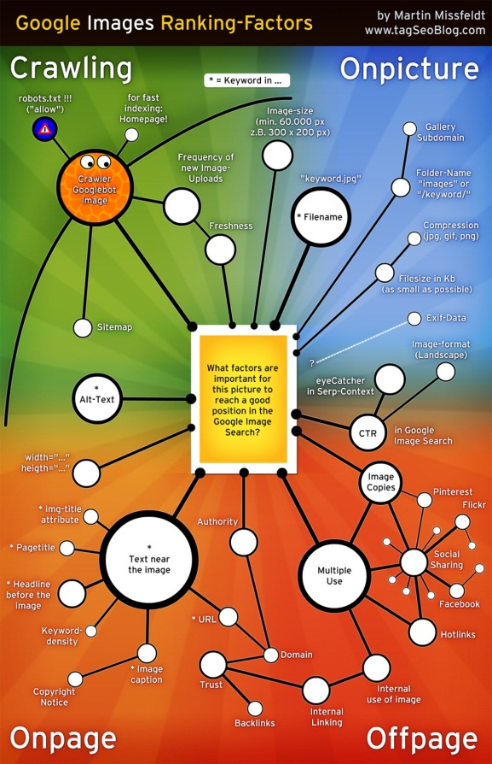
picture marketing ?
Facebook
Plusieurs espaces sur une page Facebook d'entreprise : La photo de couverture (851 x 315 pixels), qui peut être mise à jour régulièrement.
Les publications sur la Timeline : la fenêtre d'édition permet de partager des photos, qu'il est possible de ranger dans des albums. Plusieurs éléments à prendre en considération :
- Possibilité d'accompagner ces photos de textes (recommandé) - Possibilité de faire des sauts de ligne entre les éléments textuels, et ajouter des liens : l'image occupera une plus grande surface d'écran sur le flux d'actualités des membres de la page, un élément important pour capter leur attention. - Possibilité de mettre en avant la photo sur sa Timeline (elle occupera alors les deux colonnes)

Slide 36
Créer un calendrier éditorial

Slide 37
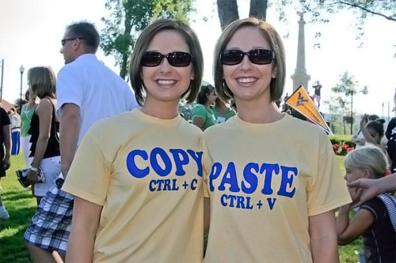
Contenus dupliqués

Slide 38
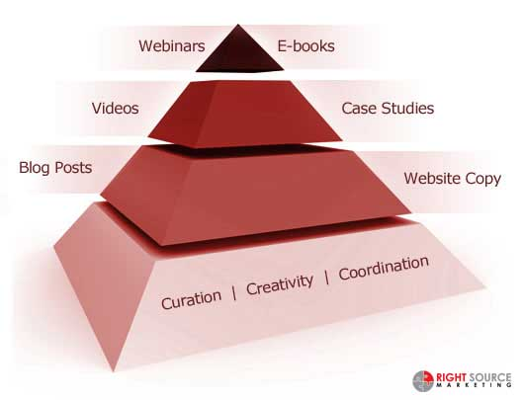
Mix de contenus

Slide 39
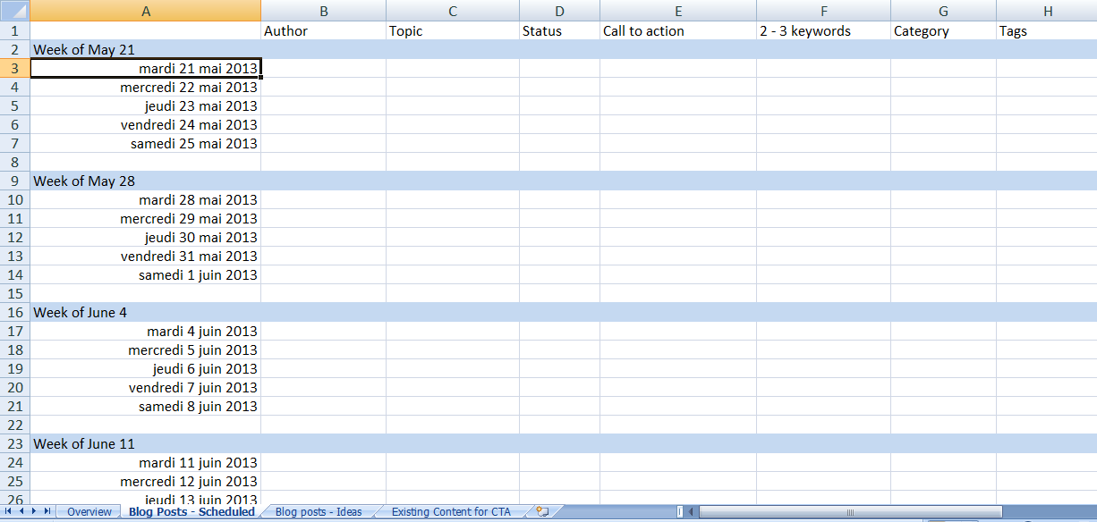
Ligne éditoriale
Cibles et objectifs connus ? À traduire en :
Ligne éditoriale (stratégie)
Charte éditoriale (work flow, structure du contenu et conventions rédactionnelles stylistiques et typographiques)
Calendrier éditorial
Notes:
2 buts:
- Planning
- Responsabilisation

Slide 40
Calendrier éditorial
Notes:
Idéal : un calendrier intégré

Slide 41
Critères

Slide 42
Processus de validation

Slide 44
Pause

